Slide 1
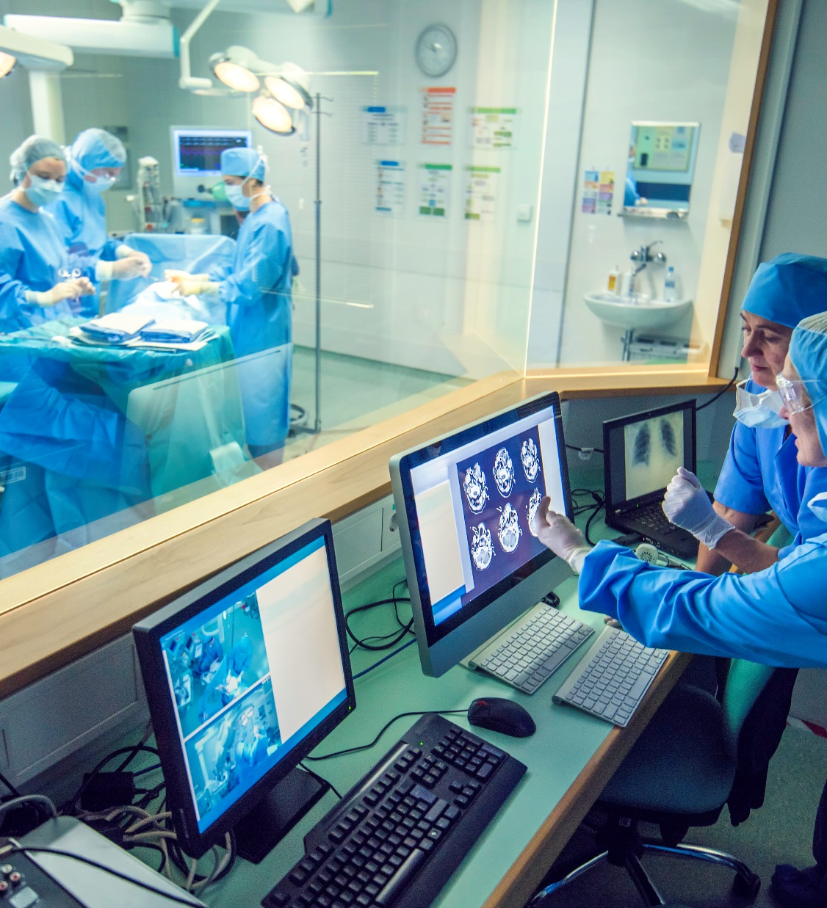
Medical

Slide 2
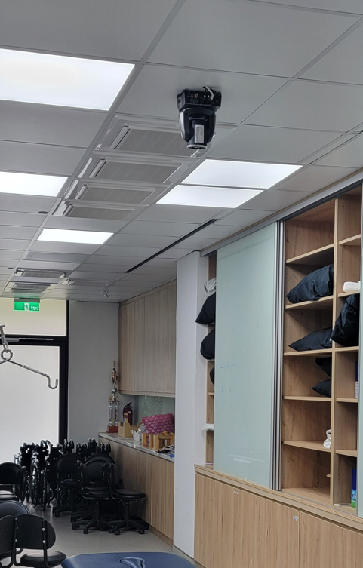

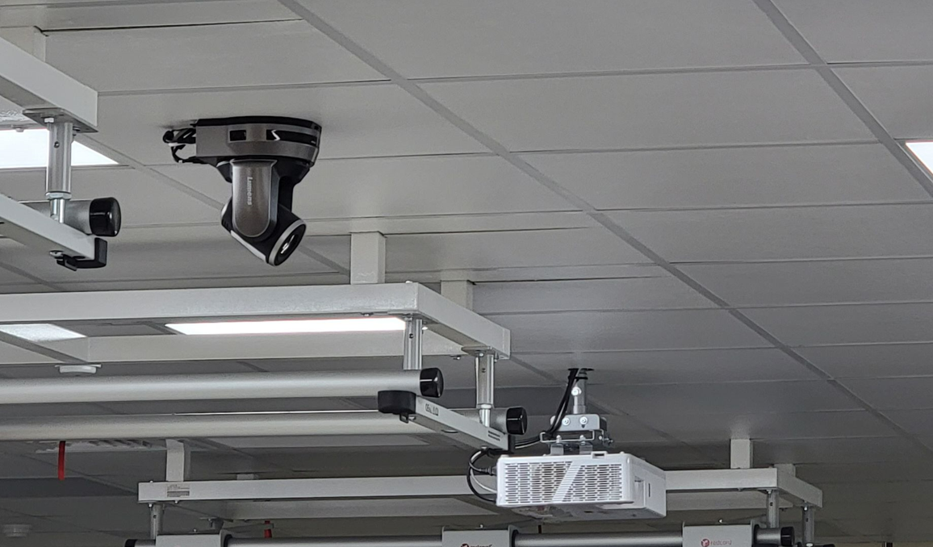




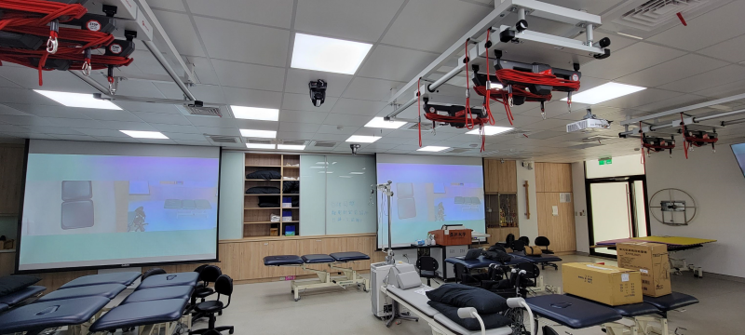
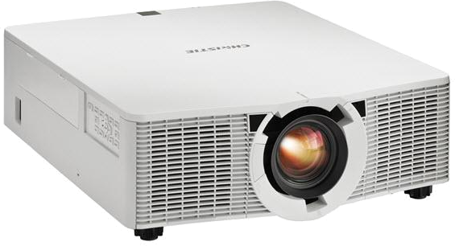
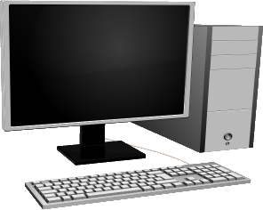
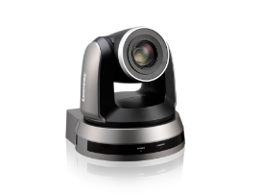

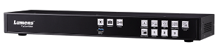
Physical Therapy Lab in ASIA UNIVERSITY
Taiwan
Success Stories
Medical
Product: VCA50P, LC200
  For the best lecture experience, a PTZ camera with adjustable framing angle and clear image is required. By connecting with the recording and streaming management, several PTZ cameras can record the demonstration from different angle at the same time, then project to every students’ monitors through the recording and streaming management host.
  This allows the students no need to gather but still have the clear vision of the demonstration. In addition, the management host can record the demonstration for review after class.
  The solution needs to be as simple as possible, so that the teachers can operate the systems without extra learning and settlement.
RJ-45
HDMI
WAN
Network Switch
VC-A50P *2
PC
LC200
Projector *2

Slide 3
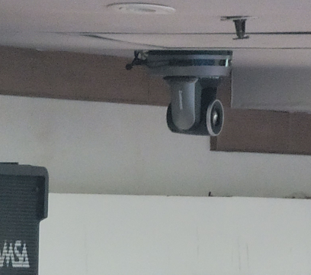

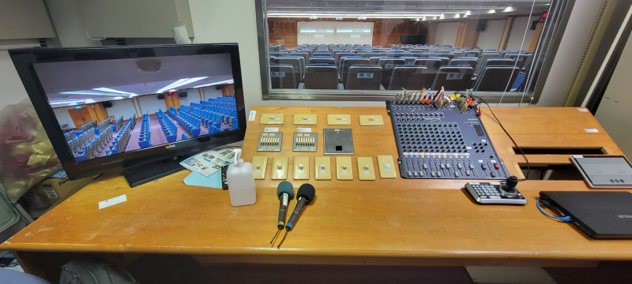
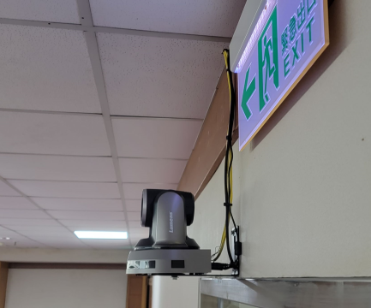
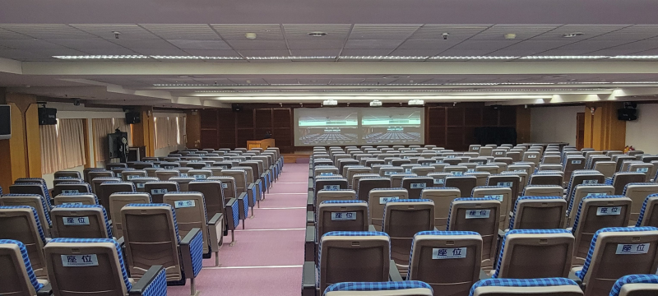

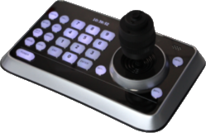
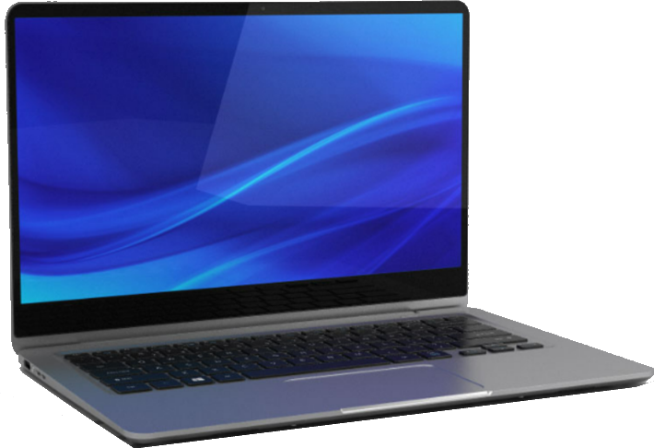
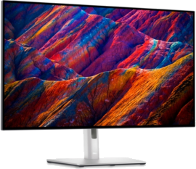
JEN-AI Hospital
Taiwan
Success Stories
Medical
Product: VCA50P, VS-K20
  In such a large conference room, a PTZ camera with high resolution and zoom function is required. In the conference room, the PTZ camera need to switch the framing mode between the speakers and the overall environment, then project to the screen with clear image to all attendees.
  It is also necessary for operators to have a control panel, so operators can easily live control the PTZ cameras or switch the preset, making the conference recording more easily and efficient.
VC-A50P
VC-A50P
Projector *3
HDMI Matrix
HDMI
Control
VS-K20
Notebook
Monitor

Slide 4
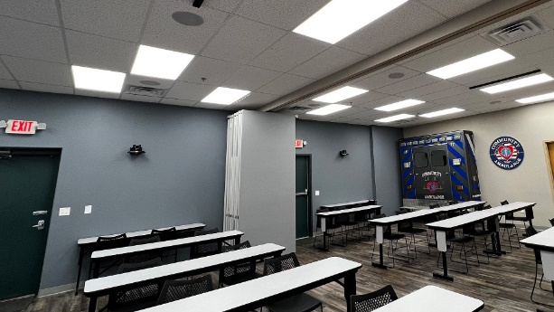

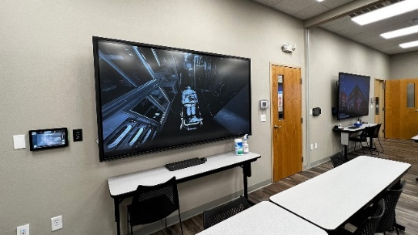
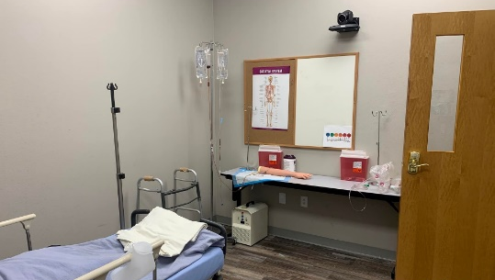
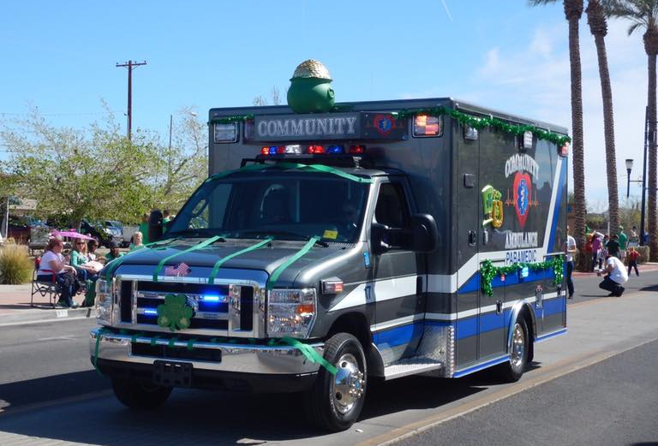
Community Ambulance Service Henderson
USA
Success Stories
Medical
T.V.S. Pro was engaged to upgrade the main large meeting space used by the Ambulance Company. The project included the requirement to divide the room into three separate training areas when needed with video conferencing and interactive AV capabilities in each area.
Product: VC-B30U
  Community Ambulance is a privately-owned ambulance service located in southern Nevada. With certified paramedics and emergency medical teams, the company is dedicated to ensuring the highest standards of patient transport care. It provides fast, professional and efficient transport in emergency and non-emergency situations, with full life support services available on-board.
To meet the brief, T.V.S. Pro installed Newline 86″ displays and an Epson interactive projector with screen, Shure MXA710 microphone arrays and Lumens PTZ cameras. All units are controlled by an EXTRON controller with dedicated touch panel control screens. A matrix switcher enables the full space or each individual room to be used for video conferencing and collaborative meetings.

Slide 5
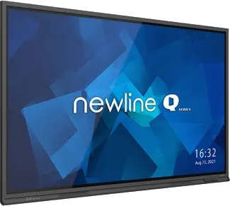
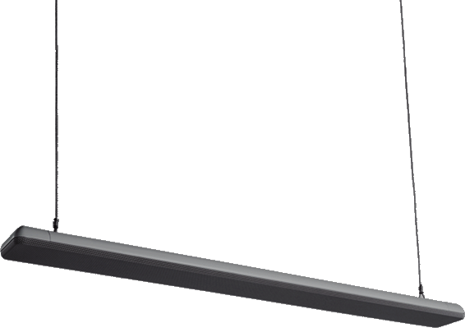
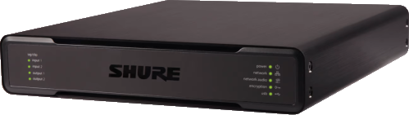
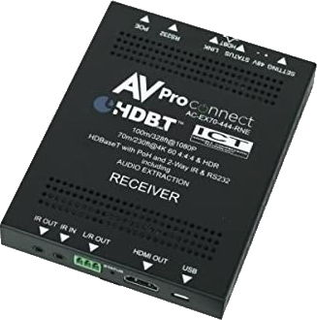
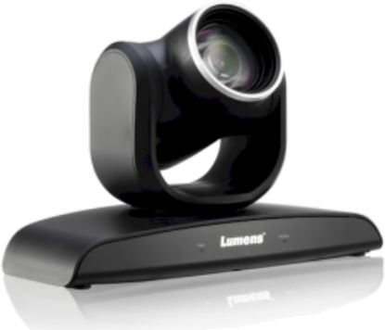
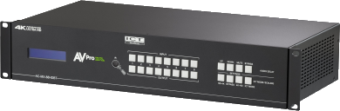
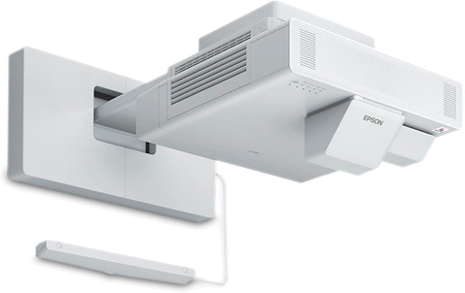
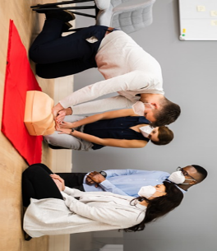
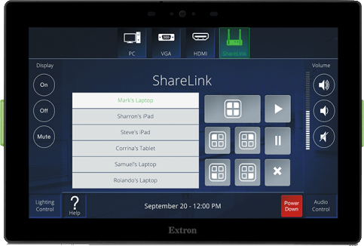
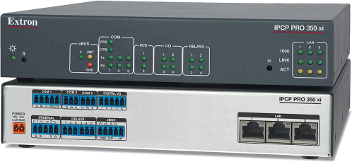
Community Ambulance Service Henderson
USA
Success Stories
Medical
Product: VC-B30U
HDMI
CAT6
Audio
RS232
SHURE MXA710
MICs
SHURE P300
MIX Processor
AVPRO
AC-EX70-444-RNE
Newline TT8619IP 86”
Touch Displays
LUMENS VC-B30U
PTZ Cameras
AVPRO EDGE 18GBPS 8X8
HDMI/HDBaseT Matrix Switch
AVPRO
AC-EX70-444-RNE
EXTRON 10”
Touch Panel
Extron IPCP Pro 350Xi
Control Processor
Epson Brightlink 1485Fi
Projector and Screen

Slide 6
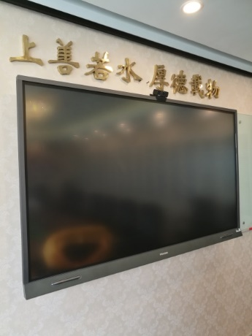
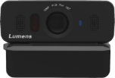




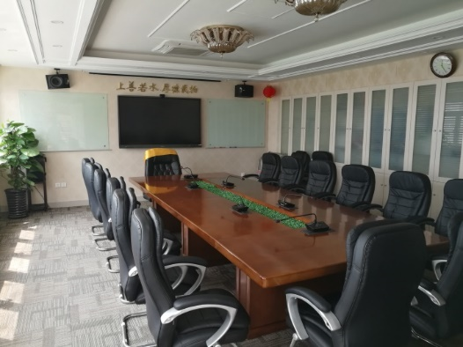
Shanghai GuoBin Medical Center
China
Success Stories
Medical
Product: : VC-B10U
Lumens Conferencing Camera
VC-B10U
  Shanghai GuoBin medical center was established in 2009. This is the first professional health examination center in China and the only health examination center approved by Shanghai Municipal Health commission.
  In the meeting room, Lumens VC-B10U is installed on the top of Hisense TV board for video conference.
  With embedded conferencing software, the employees can start multiparty conference anytime.
USB
Hisense Touch Panel
“B10U super wide viewing angle can capture the whole meeting room. B10U USB plug & play to Hisense touch panel with embedded software, users can start a video conference with ease.”

Slide 7
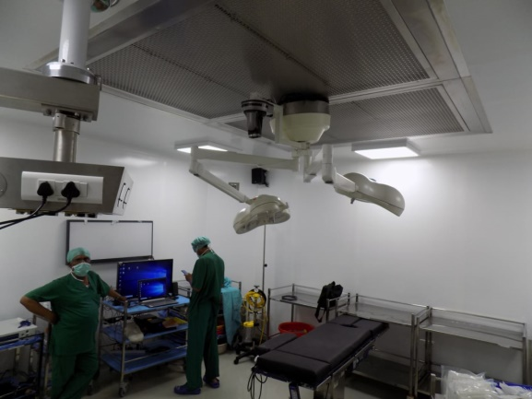
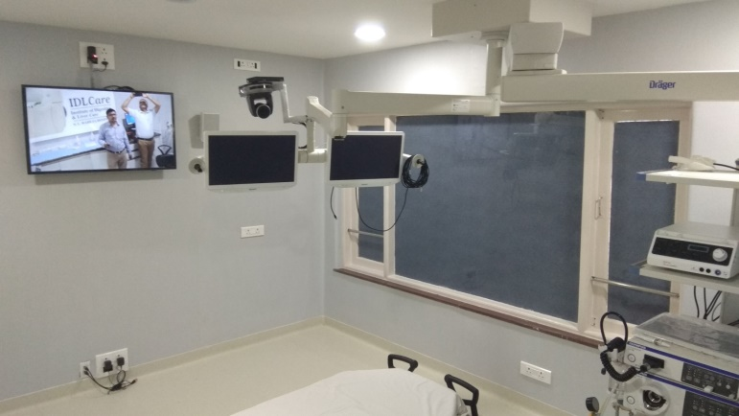
India institute of medical Sciences
India
Success Stories
Medical
Product: : VC-A50P, PS752, VS-LC102
  In the seminar rooms, three VC-A50P are installed for presenter and audience view. One PS752 is for X-Rays. All cameras are connected to VS-LC102 media processor for recording and streaming.
  In the operation rooms, VC-A50P are installed to capture the whole surgery process
  When needed, LC102 is connected to the PC software codec for the video conferencing.
“Lumens offers the complete solution including recording hardware, IP cameras, and visualizers for X-rays. The medical institution is very happy with the video quality and ease of use of our products”
Univeso Integrated Solutions

Slide 8



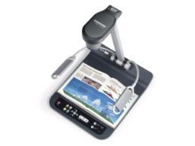
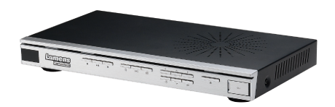
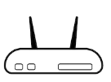


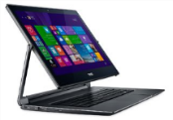

India institute of medical Sciences
India
Success Stories
Medical
Product: : VC-A50P, PS752, VS-LC102
Lumens PTZ Camera
VC-A50P
HDMI
Video Switcher
HDMI
Cat 5e
Cat 5e
Cat 5e
Display
HDMI
Lumens
Lecture Capture System
VC-LC102
Cat 5e
RTP/RTMP
Streaming
Network Device
Lumens Desktop Camera
PS752
Recording
HDMI
Central server
USB
Converter
VC software codec

Slide 9
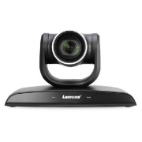
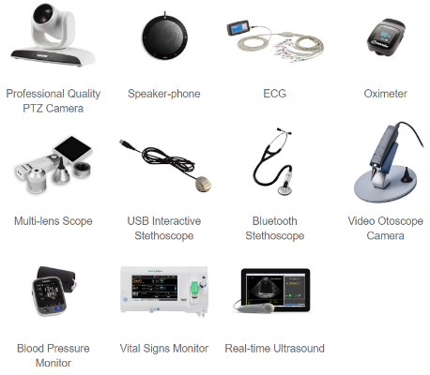
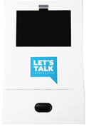
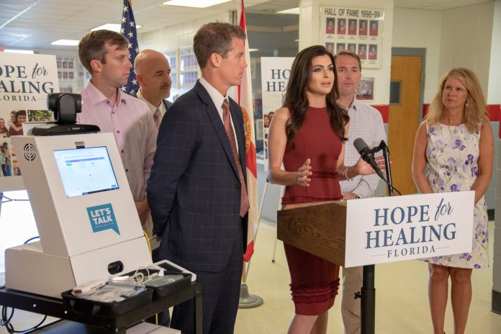
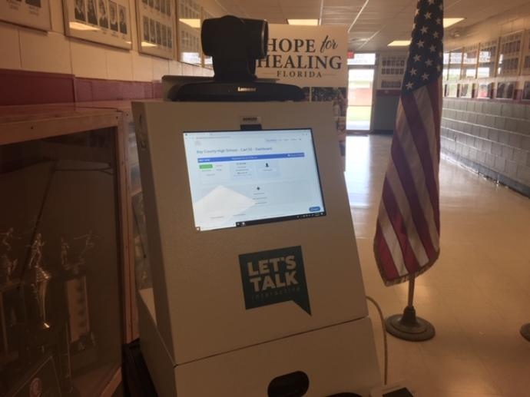
Florida Telehealth Portals In K-12 Public schools
USA
Success Stories
Medical
Lumens PTZ Camera
VC-B30U
Other Telehealth technology can be used with Kiosk
Product: : VC-B30U
USB
  63 Telehealth portals will be in public schools throughout six counties to provide mental health services to students recovering from Hurricane Michael.
  PTZ Camera B30U is placed on the top of the Howard Technology telehealth kiosk to provide live feed for video conferencing between students and mental health providers.
HOWARD TECHNOLOGY SOLUTION
Telehealth Kiosk
“It’s an innovative technology that students can really participate in the video conferencing section , think of Facetime with mental health providers”
Casey DeSaintis
Florida First Lady

